Slide 2

Initial concept
2D character design
Abstract design (based on board game pawn)
Monocle for facial detail
Body like detective trench coat

Slide 3

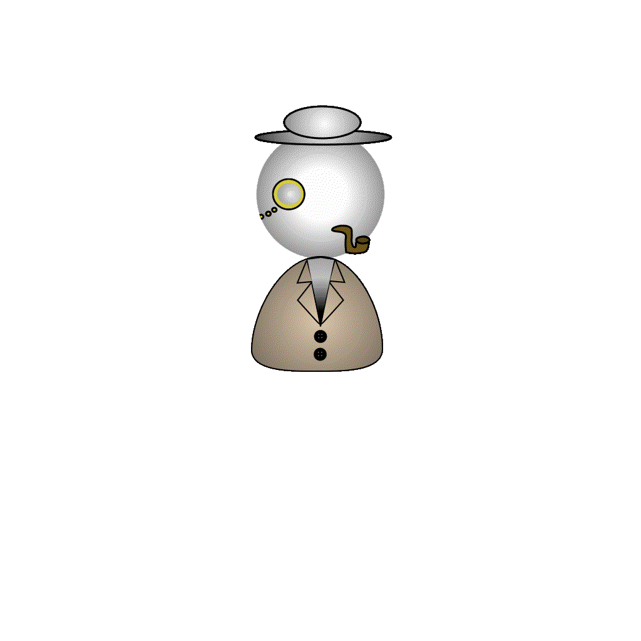
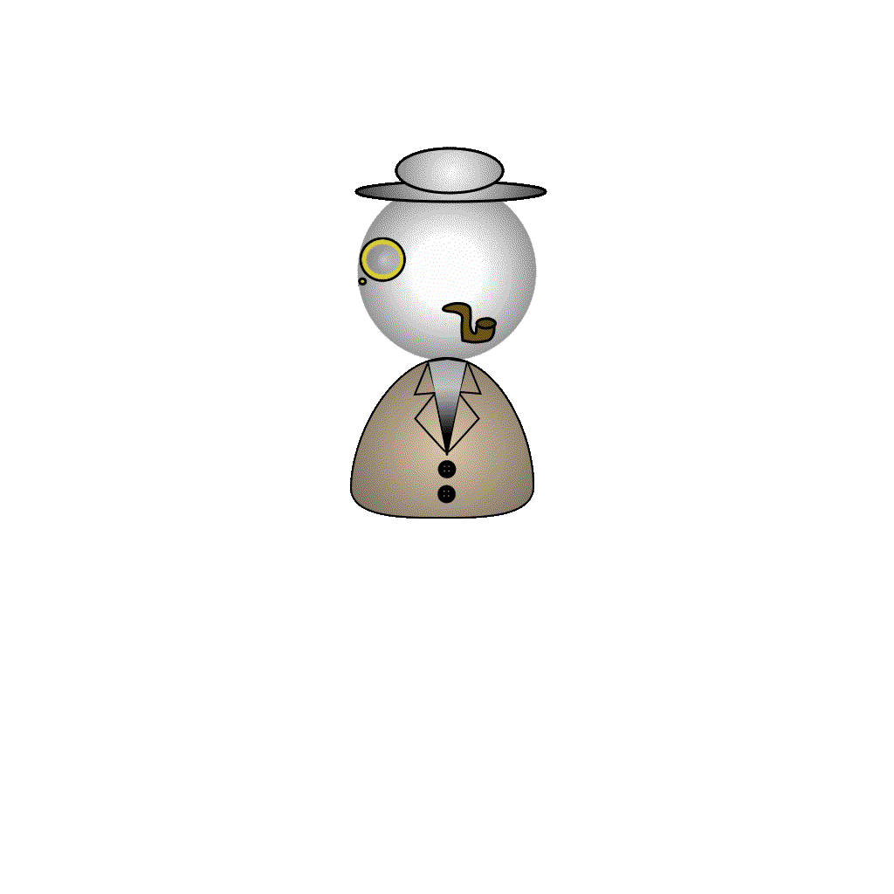
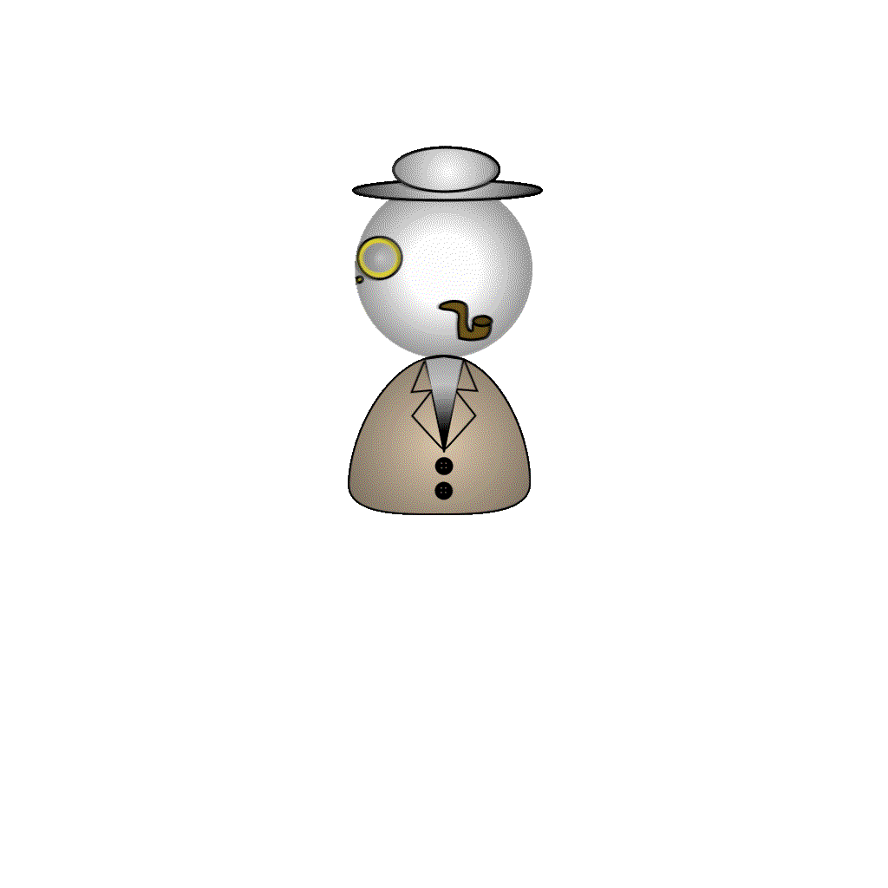


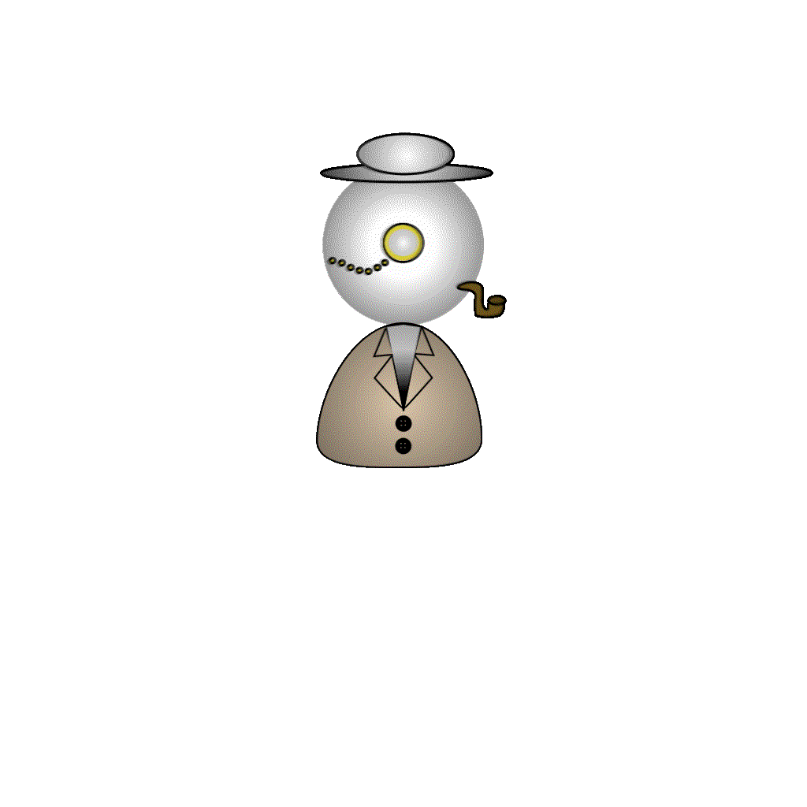
Character animation
Turning
Moving
Idle
Return from position

